Slide 1
Report on analysis of the power consumption
2018/07/31
Qing Wu

Slide 2
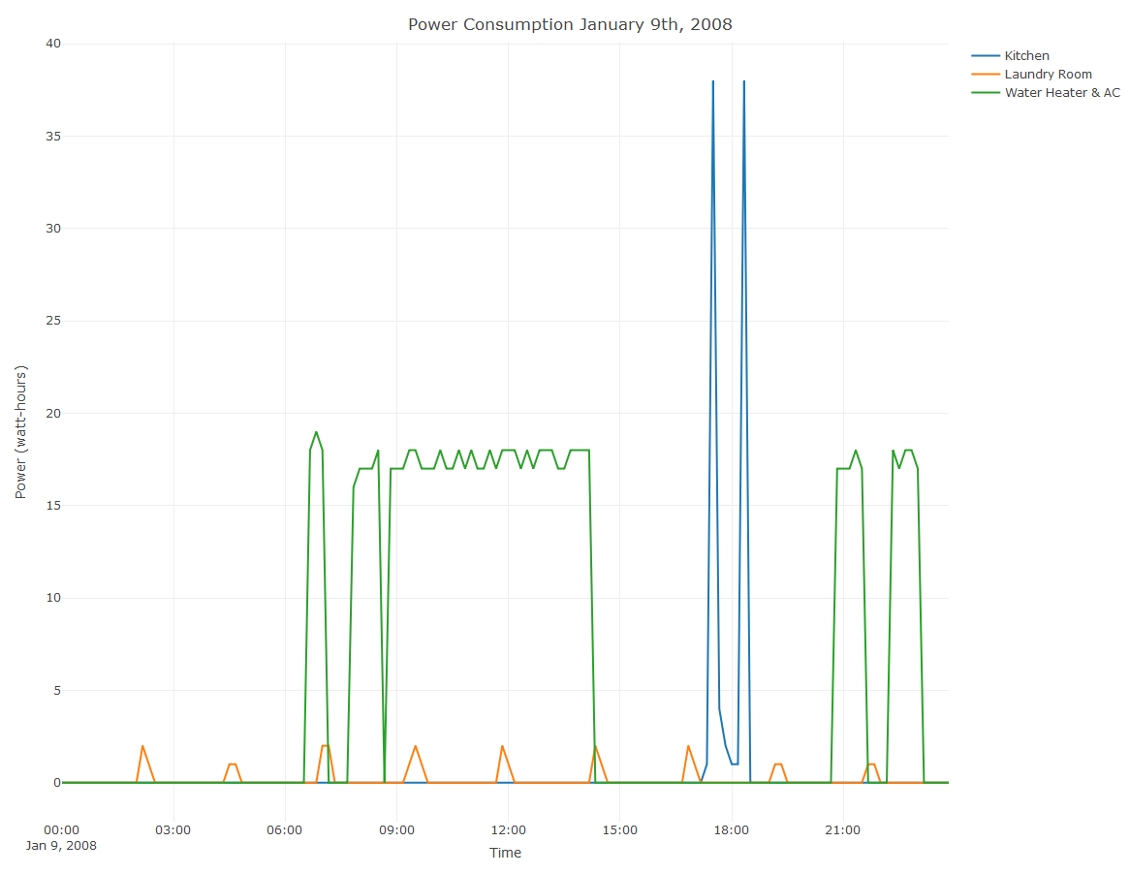
Power Consumption on January 9th,2008- 10 Minute Interval
Kitchen appliance was used two times this day. The peak usage of kitchen was around 5:20 and 6:20 pm. The laundry appliance was used 9 times this day with small power consumption. The peak usage of water heater &AC is around 6:30am to 7:10am, 7:40 am to 15:00 pm, 20:40pm to 21:40pm,22:00pm to 23:30pm. The largest percentage of power consumption was water heater & AC during this day.

Slide 3
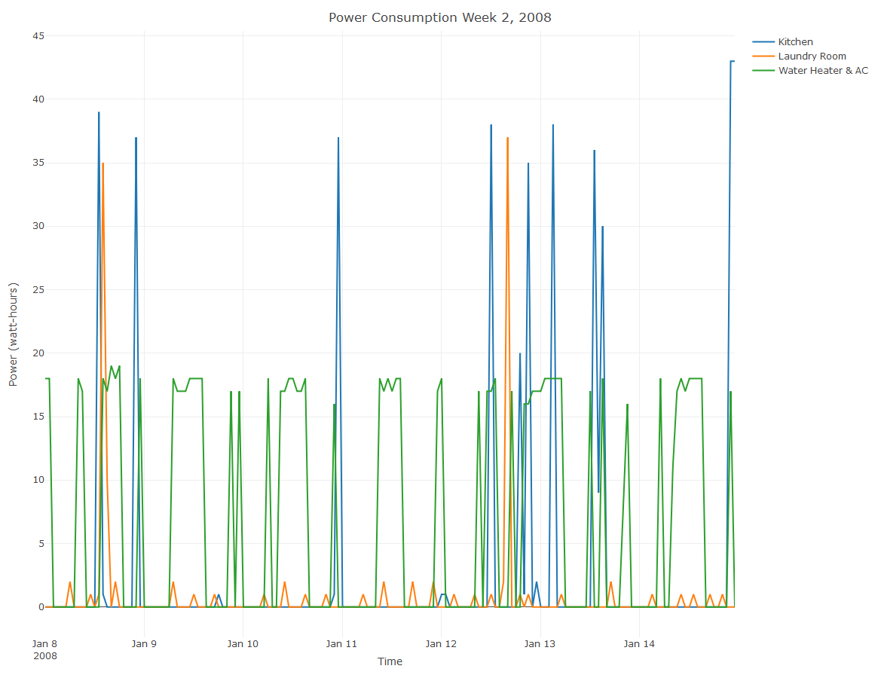
Power Consumption in Week 2, 2008 - 1 hour frequency
In the second week of 2008, the weekend (Jan 12 and Jan 13) have higher power consumptions of kitchen appliance than weekdays. Only two days of this week(Jan 8 and Jan 12) have higher power usage of Laundry appliance than other days. The peak time of usage of water heater &AC in weekend is different from weekday, which showed home owners may have different schedule between weekday and weekend.

Slide 4
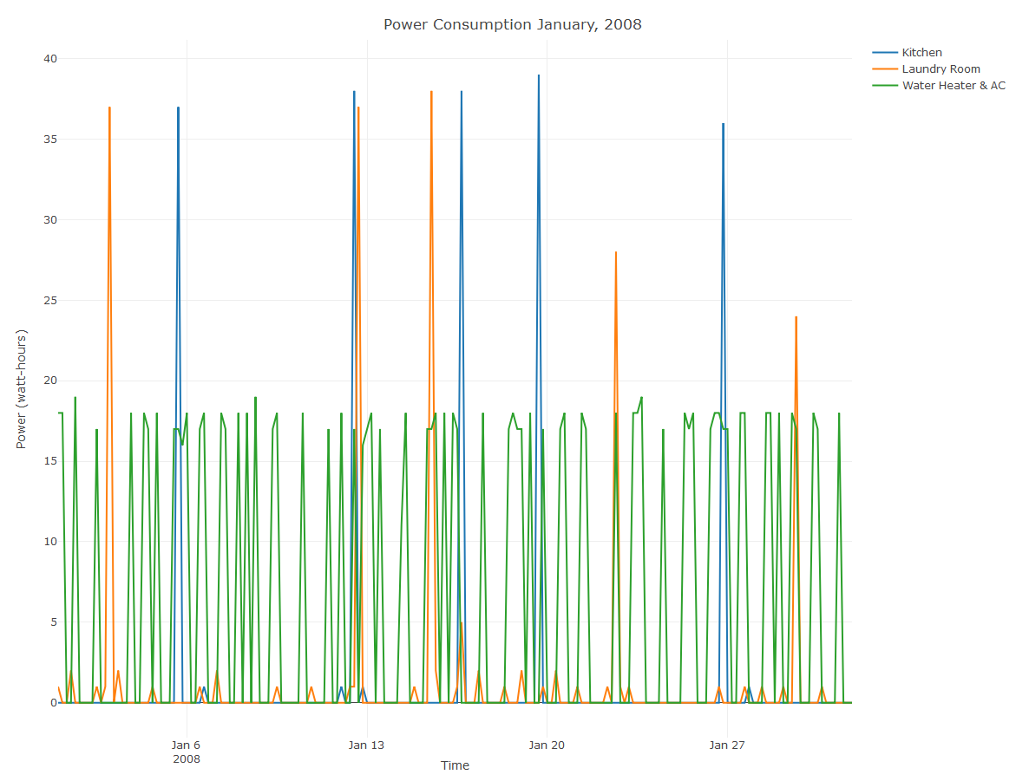
Power Consumption in January, 2008 - 6 hours frequency
The third week has more peaks of power usage of kitchen appliance than other weeks in January,2oo8. The highest peak of laundry room power usage in the fourth and fifth week of this month is lower than other weeks. The power usage of water heater &AC is almost the same among each week during this month.

Slide 5
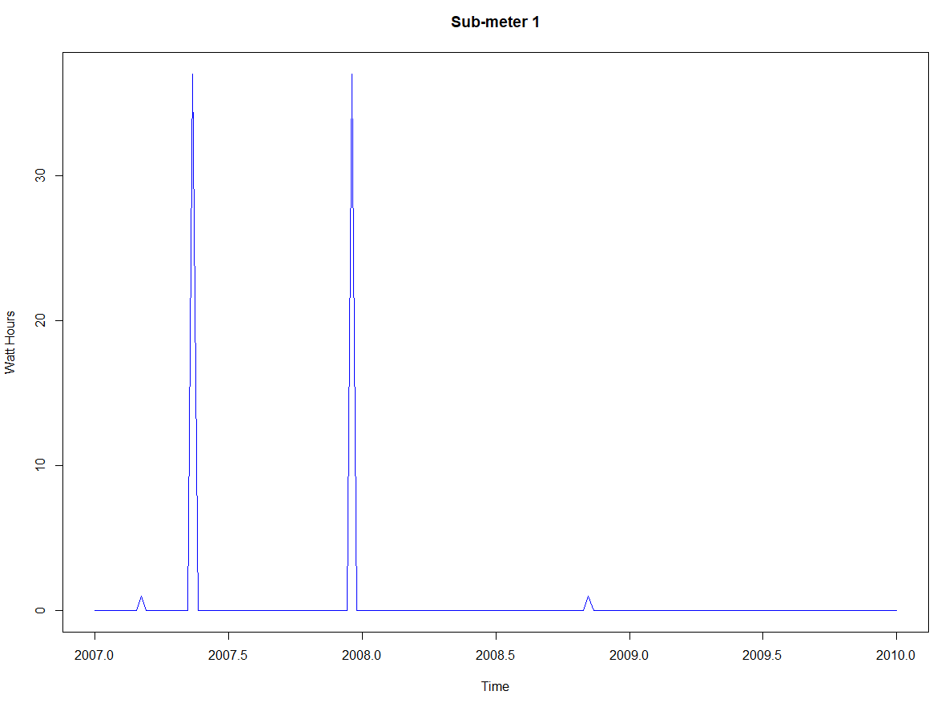
Sub-meter 1 time series plot
The power usages of kitchen appliance in one week of April,2007 and Dec,2007 were much higher than other weeks on Mondays at 8:00pm for 2007, 2008 and 2009.

Slide 6
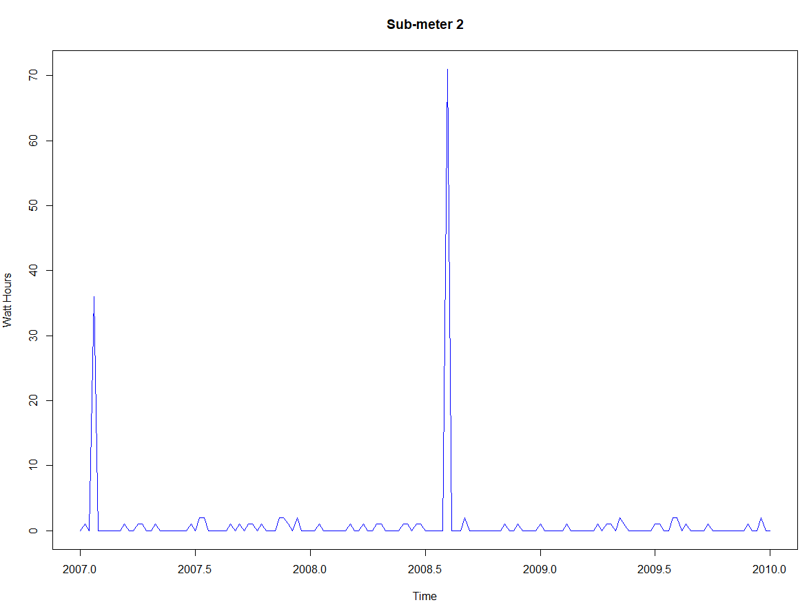
Sub-meter 2 time series plot
The power usages of laundry appliance in one week of Jan,2007 , especially June,2008 were much higher than other weeks on Mondays at 8:00pm for 2007, 2008 and 2009.

Slide 7
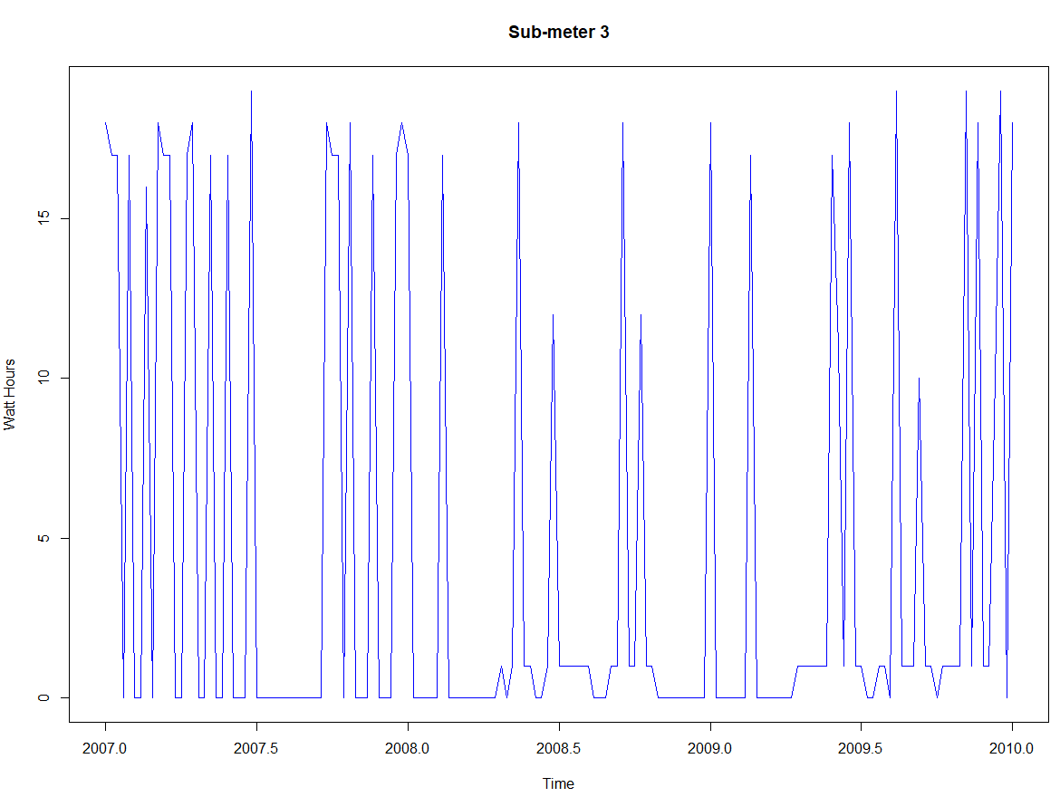
Sub-meter 3 time series plot
The power usages of water heater and AC in June, July and August of 2007, 2008 , March and June of 2009 was much lower than other months during these three months.

Slide 8
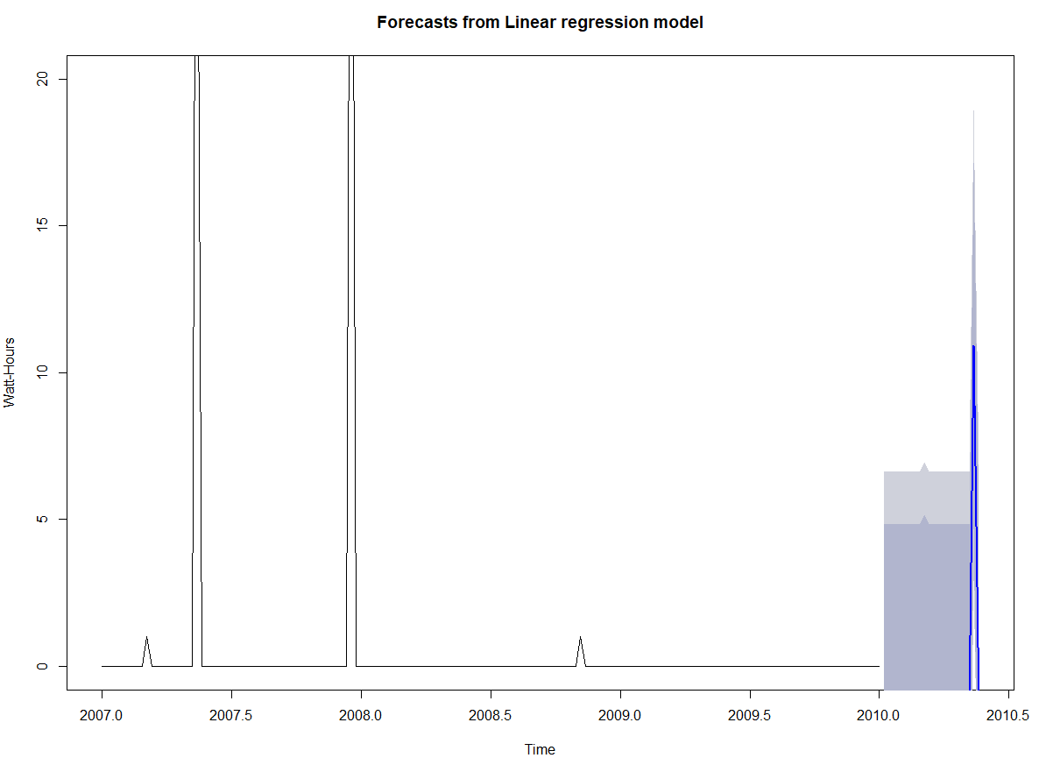
Forecasting for sub-meter 1 with confidence levels 80 and 90

Slide 9
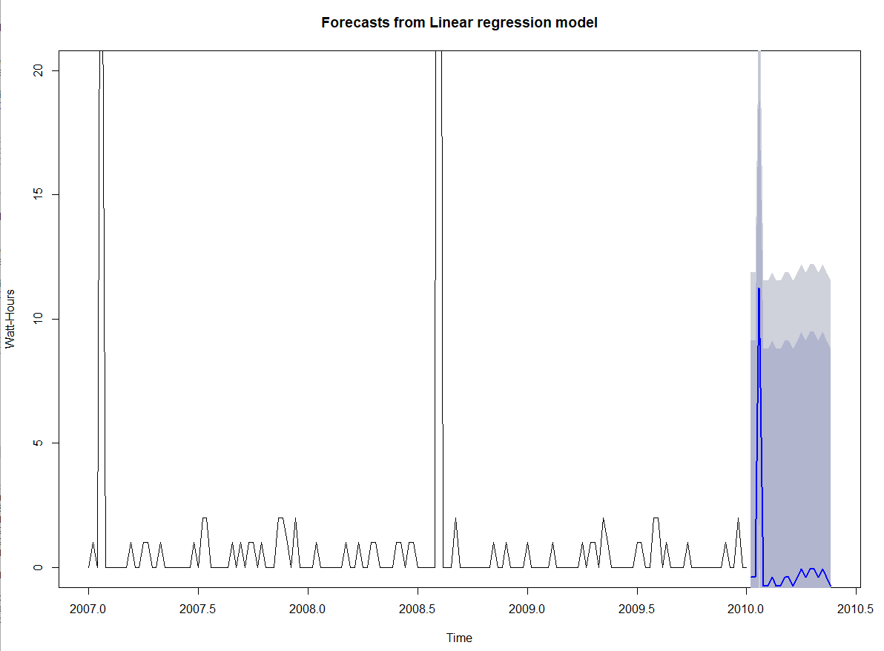
Forecasting for sub-meter 2 with confidence levels 80 and 90

Slide 10
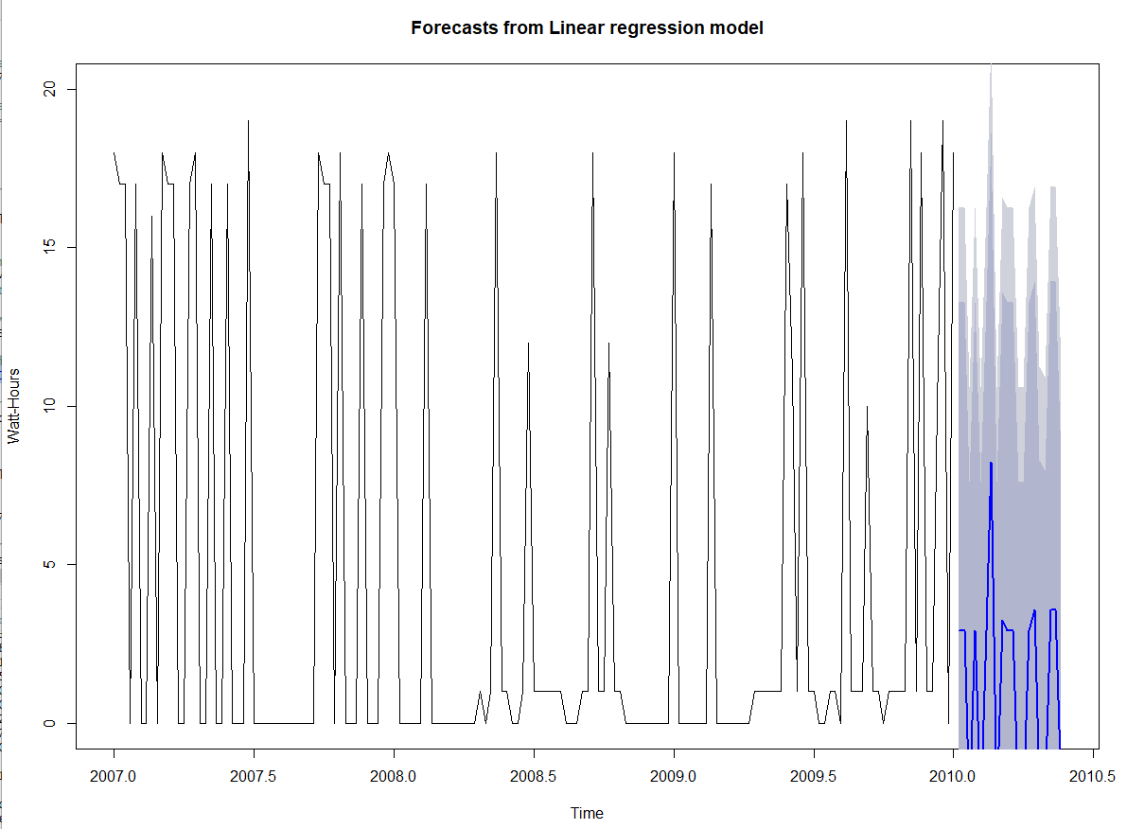
Forecasting for sub-meter 3 with confidence levels 80 and 90

Slide 11

The chart below compared the R2 and RMSE of each model
The R square of these three Linear Regression Forecast model were not high, which showed we needed to improve our model.

Slide 12
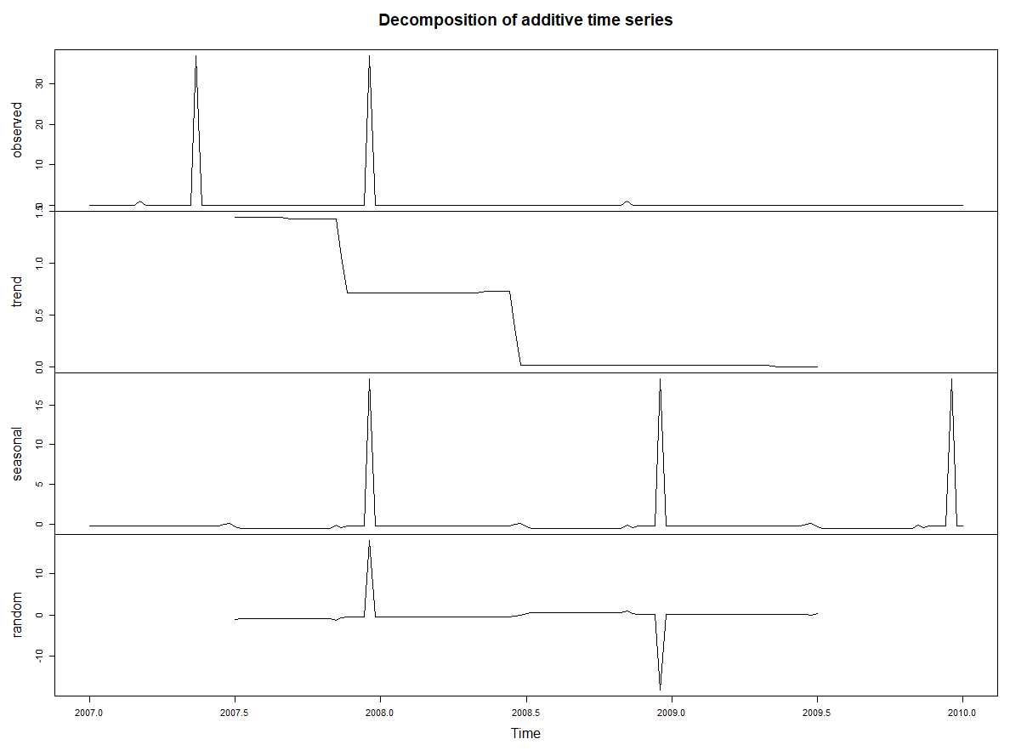
Decompose Sub-meter 1 into trend, seasonal and remainder
The trend of kitchen appliance power consumption had two sharp decrease in Oct,2007 and April ,2008. Kitchen appliance power consumption also had seasonal pattern.

Slide 13
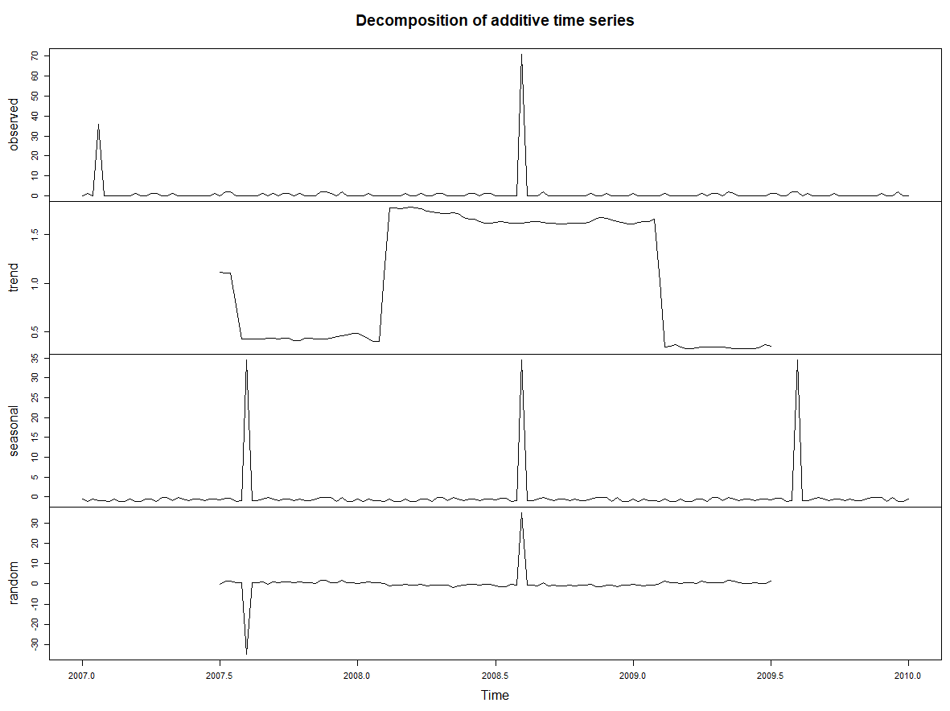
Decompose Sub-meter 2 into trend, seasonal and remainder
The chart reveals that there is no trend in the laundry appliance power consumption. Laundry appliance power consumption also had seasonal pattern.

Slide 14
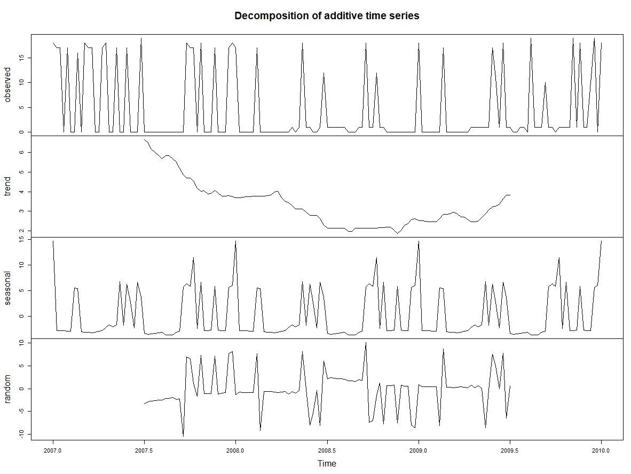
Decompose Sub-meter 3 into trend, seasonal and remainder
The trend of water heater & AC power consumption decreased over time from May,2007 to Dec,2008 and increased quite slowly from Dec 2008 to May 2009. Water heater & AC power consumption also had seasonal pattern.

Slide 15



Summary statistics for the seasonal, trend and remainder components for
sub-meters 1, 2 and 3

Slide 16
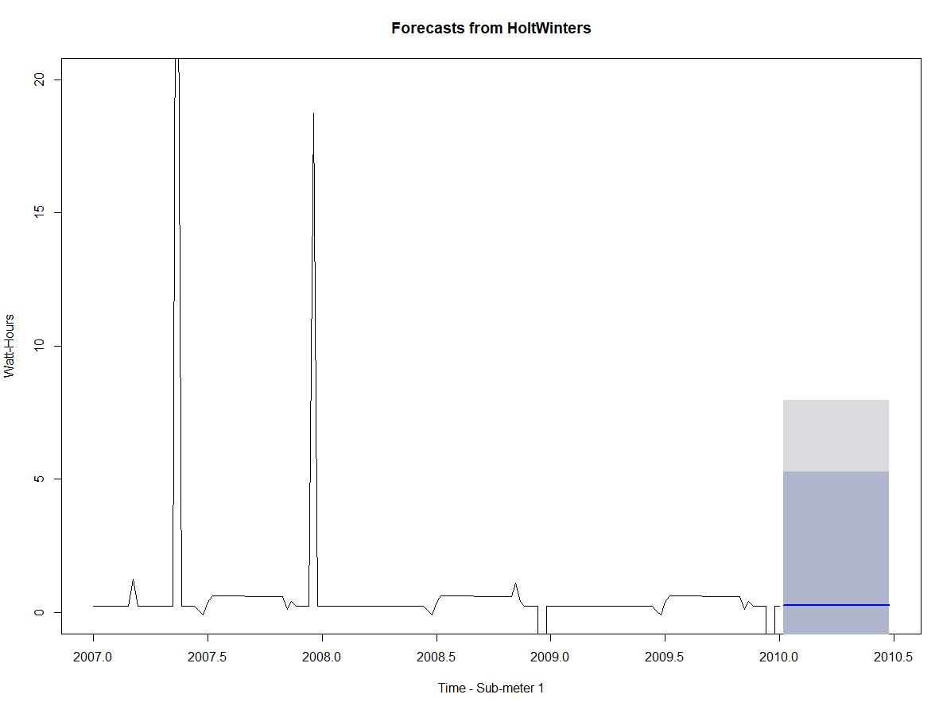
HoltWinters forecast & plot for Sub-meter1 with diminished confidence levels

Slide 17
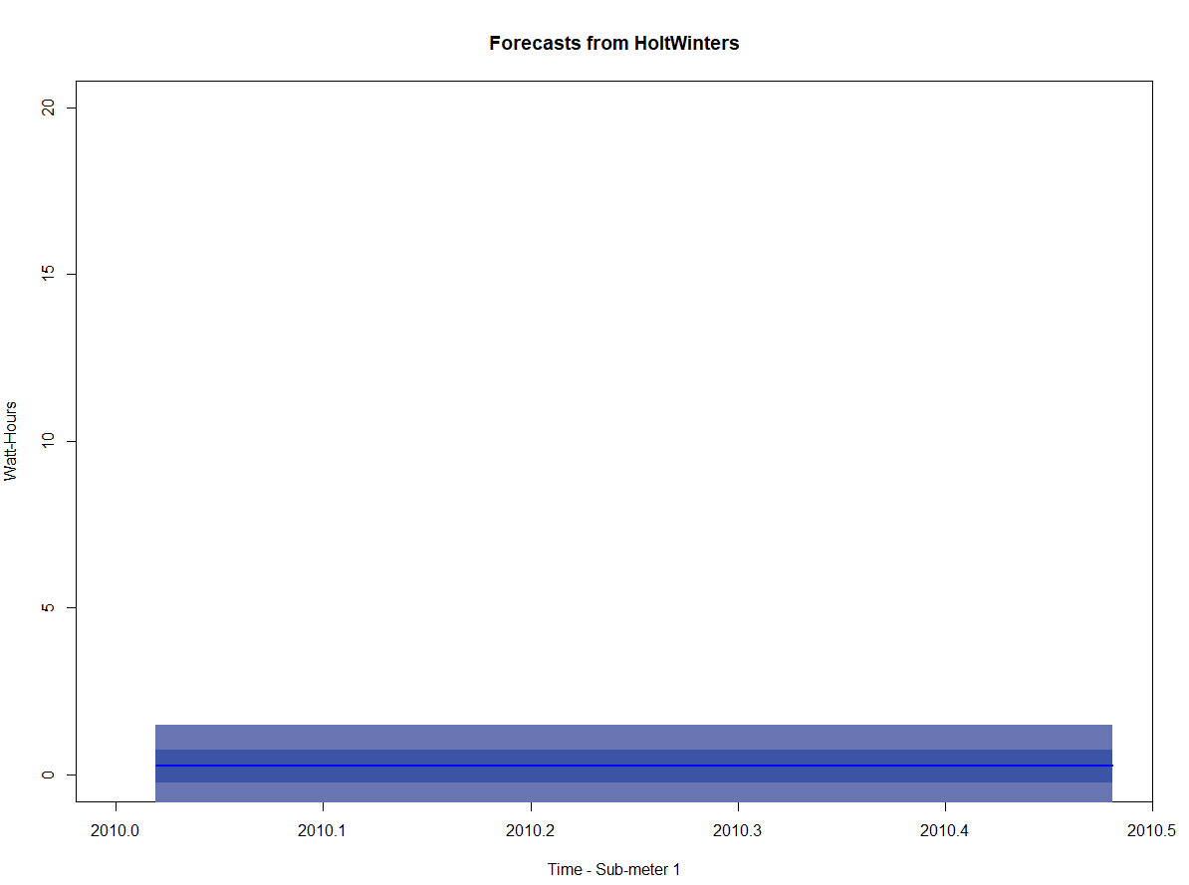
HoltWinters forecast & plot for Sub-meter1 containing only the forecasted area

Slide 18
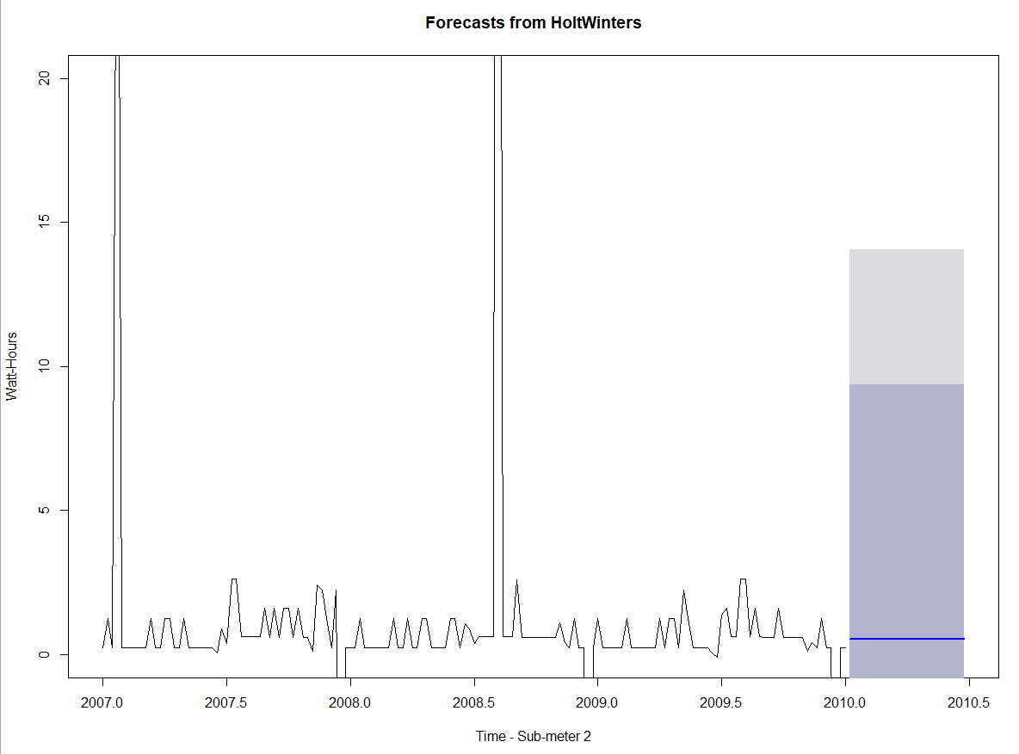
HoltWinters forecast & plot for Sub-meter2 with diminished confidence levels

Slide 19
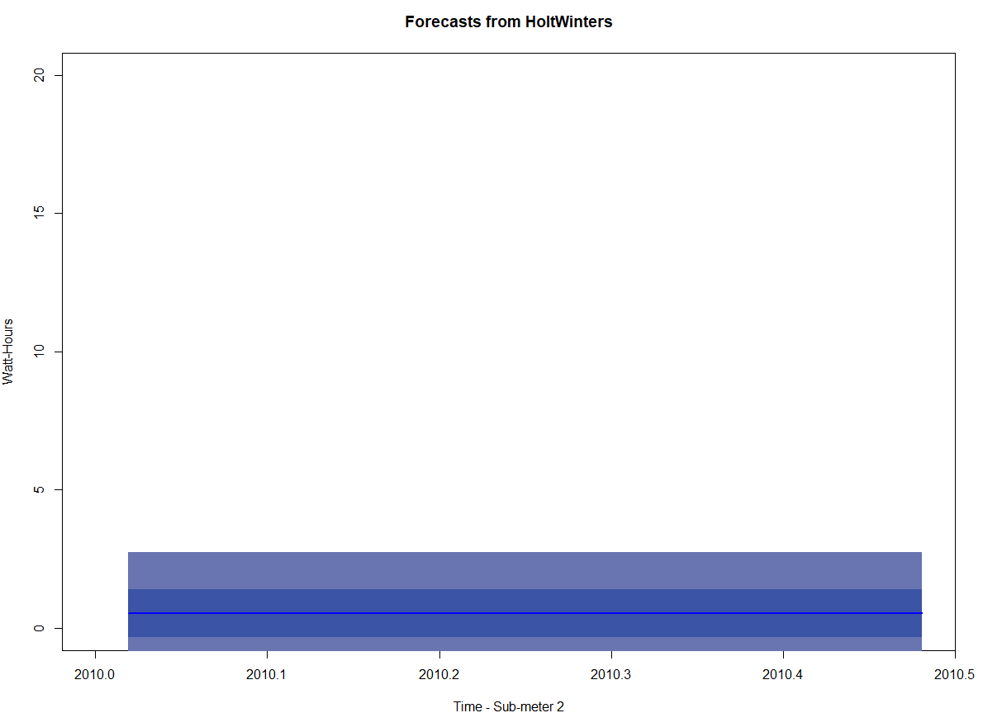
HoltWinters forecast & plot for Sub-meter2 containing only the forecasted area

Slide 20
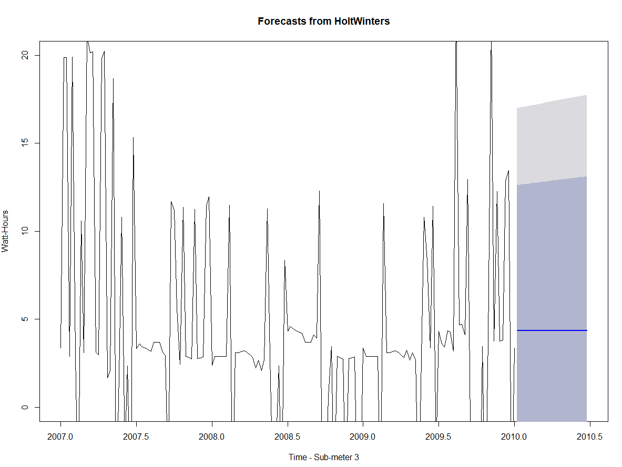
Holt-Winters forecast & plot for Sub-meter3 with diminished confidence levels

Slide 21
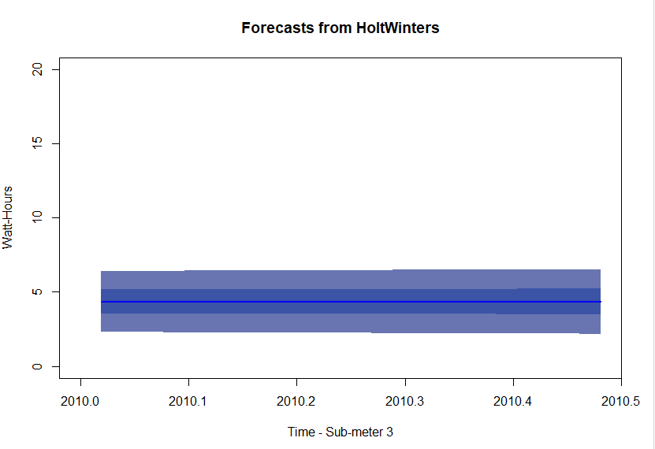
HoltWinters forecast & plot for Sub-meter3 containing only the forecasted area

Slide 22
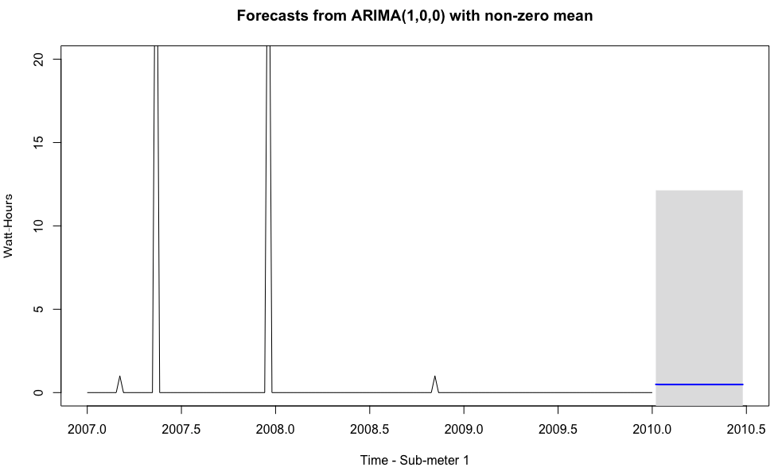
ARIMA Model forecast & plot for Sub-meter1 with 99.5% confidence level

Slide 23
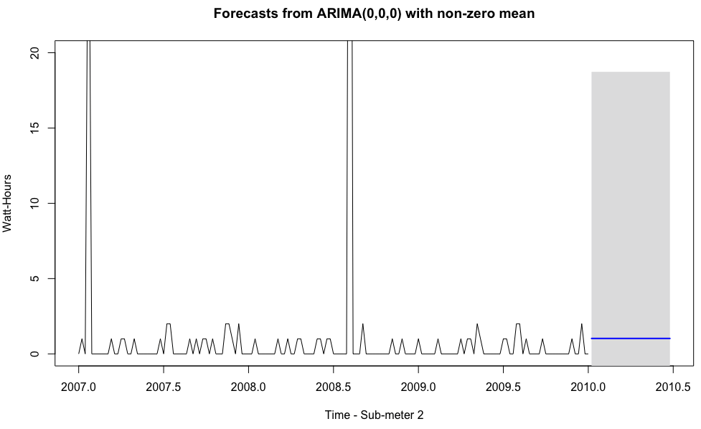
ARIMA Model forecast & plot for Sub-meter2 with 99.5% confidence level

Slide 24
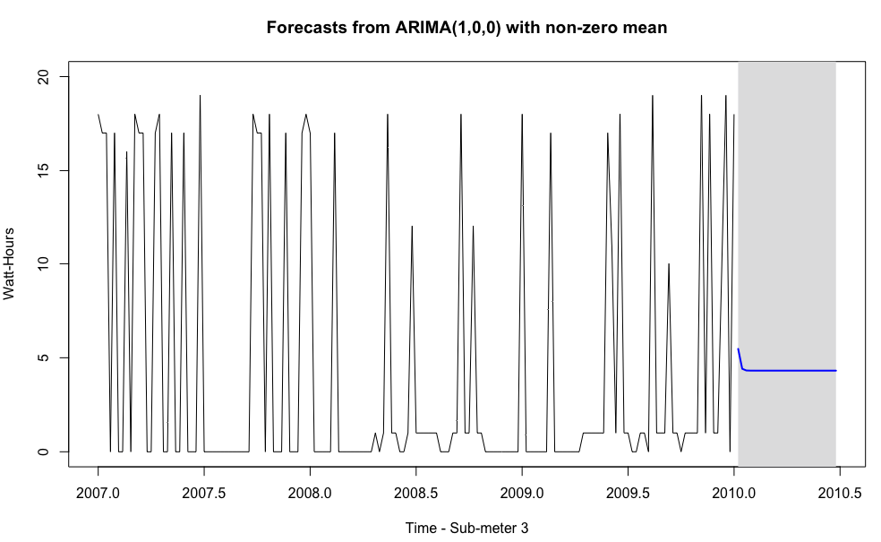
ARIMA Model forecast & plot for Sub-meter3 with 99.5% confidence level

Slide 25
Useful predictions gleaning from the data
The predicted power consumption of water heater & AC by Holt-Winters was higher than kitchen and laundry room, which was in accordance with previous conclusion.
The prediction of these three sub-meters by Holt-Winters showed the underlying trends of these sub-meters more clearly.
Since we made forecasting using simple exponential smoothing and removed the seasonal component, the resulting image of Holt-Winters shows a very consistent forecast for sub-meter 1,2,3 respectively.
The predictions of these three sub-meters by linear regression model were quite different from Holt-Winters , because they included the seasonal components. These two predictions were both useful, because they showed seasonal and non-seasonal forecasting of data.

Slide 26
Five business recommendations
Since Kitchen appliances had the highest power usage per hour around 17:30pm to 18:30pm in a day, home owner can use your kitchen appliances more efficiently ,such as using microwave, rather than oven, for reheating small items.
Water heater & AC has the largest percentage of power consumption during this day, which maybe show there were some issues with the water heater & AC appliance, such as aging problems. Home owner would check these machines, and choose energy-efficient appliances to save more money.
The laundry room power usage had one or two peaks during the week, and home owner can use your washing machine and dryer more efficiently, such as setting your washing machine to wash your clothes in cold water, cleaning the lint out of the filter of the dryer after each use, considering buying a high-efficiency washing machines, etc.
Since there are some outliers of kitchen appliance power usage and laundry room power usage, which may indicate some appliance issues. Home owner needed to check these appliance and tried to find out and fix these issues through maintenance or replacements.
Since there are some trends in these three sub-metering, home owner needed to pay more attention to these trends, which can help them better monitor their power usage in the long term.

Slide 27
A summary statement that addresses the goal of this project
After analyzing this data gathered by sub-metering devices and creating analytics and visualizations of this data from different angles such as Day, Week and month period visualization, we gained deep insight into the patterns of power consumptions of Smart Home owners, which can help home owner to monitor and control over power consumption, and detect appliance problems and also can help developers to attract more customers by providing sub-metering devices and gain competitive advantage.

Slide 28
Lessons learned
Visualizations is an effective method to find interesting and valuable business patterns. Understanding the importance of granularity, we can get the most meaningful visualizations to present to our clients, which can help them better understand the power consumption patterns of home owners and better promote highly efficient Smart Homes.
After building different time series regression models and make seasonal and non-seasonal forecasting , we can better understand both the underlying trend in the data and seasonal impact on the data, which can help us gain deep insight into the data and make actionable decisions.

